Slide 1
Blackboard / Gwinnett County Public Schools Product Call May 2020

Slide 2
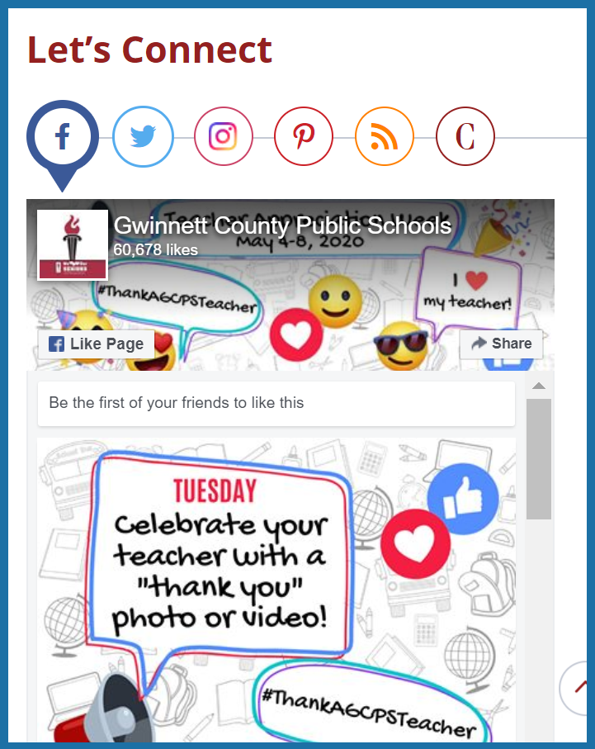
Accessibility & Responsiveness
Brenton Kelly
Senior Manager, Web Development
Social Media
Facebook
Twitter
Instagram
Pinterest
Embed Code
Google Slides

Slide 3
Google Calendar Syncing Solution
Google Calendar | Google Calendar owners are notified when the sync token fails during a Google Calendar Watch handler request
 | Google Calendar owners are notified when the nightly RenewGoogleWatch job fails so they can repair or report the connection as broken
Can the email be picked up from another field within Bb?
Site Settings – Contact – Email Address
Site Settings – Advanced – Calendar Notification Email
High level summary of the scenarios that were corrected with the recent April 23rd release and the other two sprints related to Google calendar sync. The goal is to understand how we can communicate to school webmasters about calendar syncing.
Has Bb seen a decrease in calendar syncing support tickets with the updates?

Slide 4
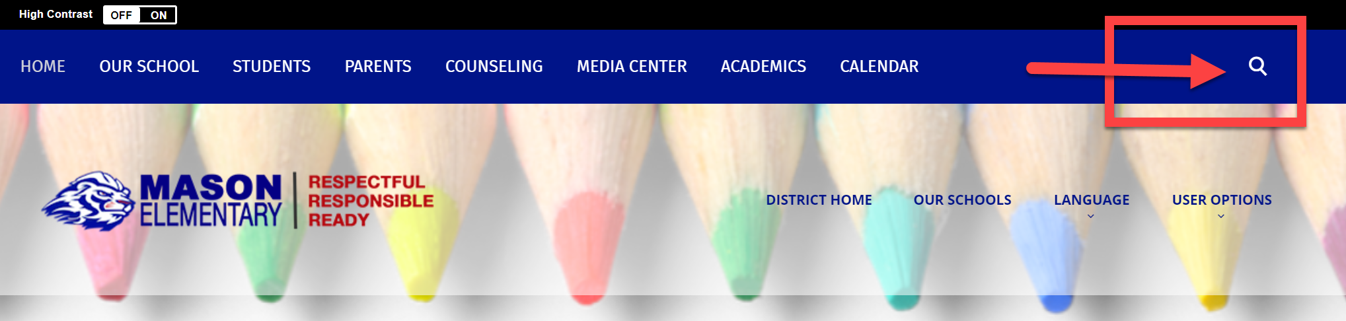
Search Discussion
Overview – Blackboard Search functionality
Please explain how search results are pulled within a Bb subsite?
What can be done to help improve search results on a page?
Note: Gwinnett does not have Google search enabled.

Slide 5
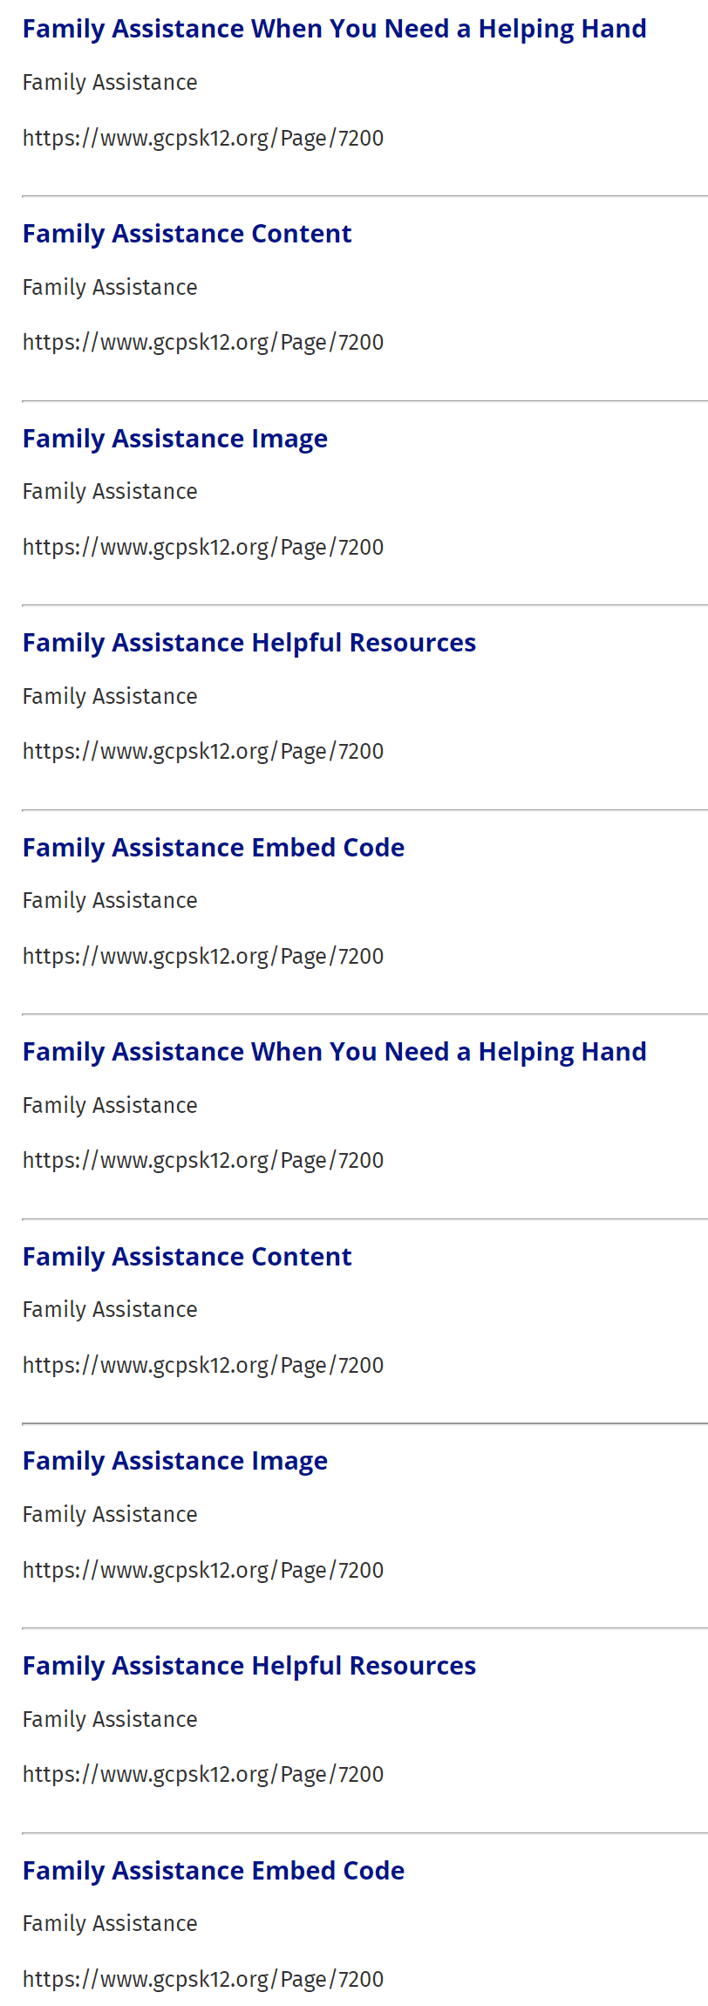
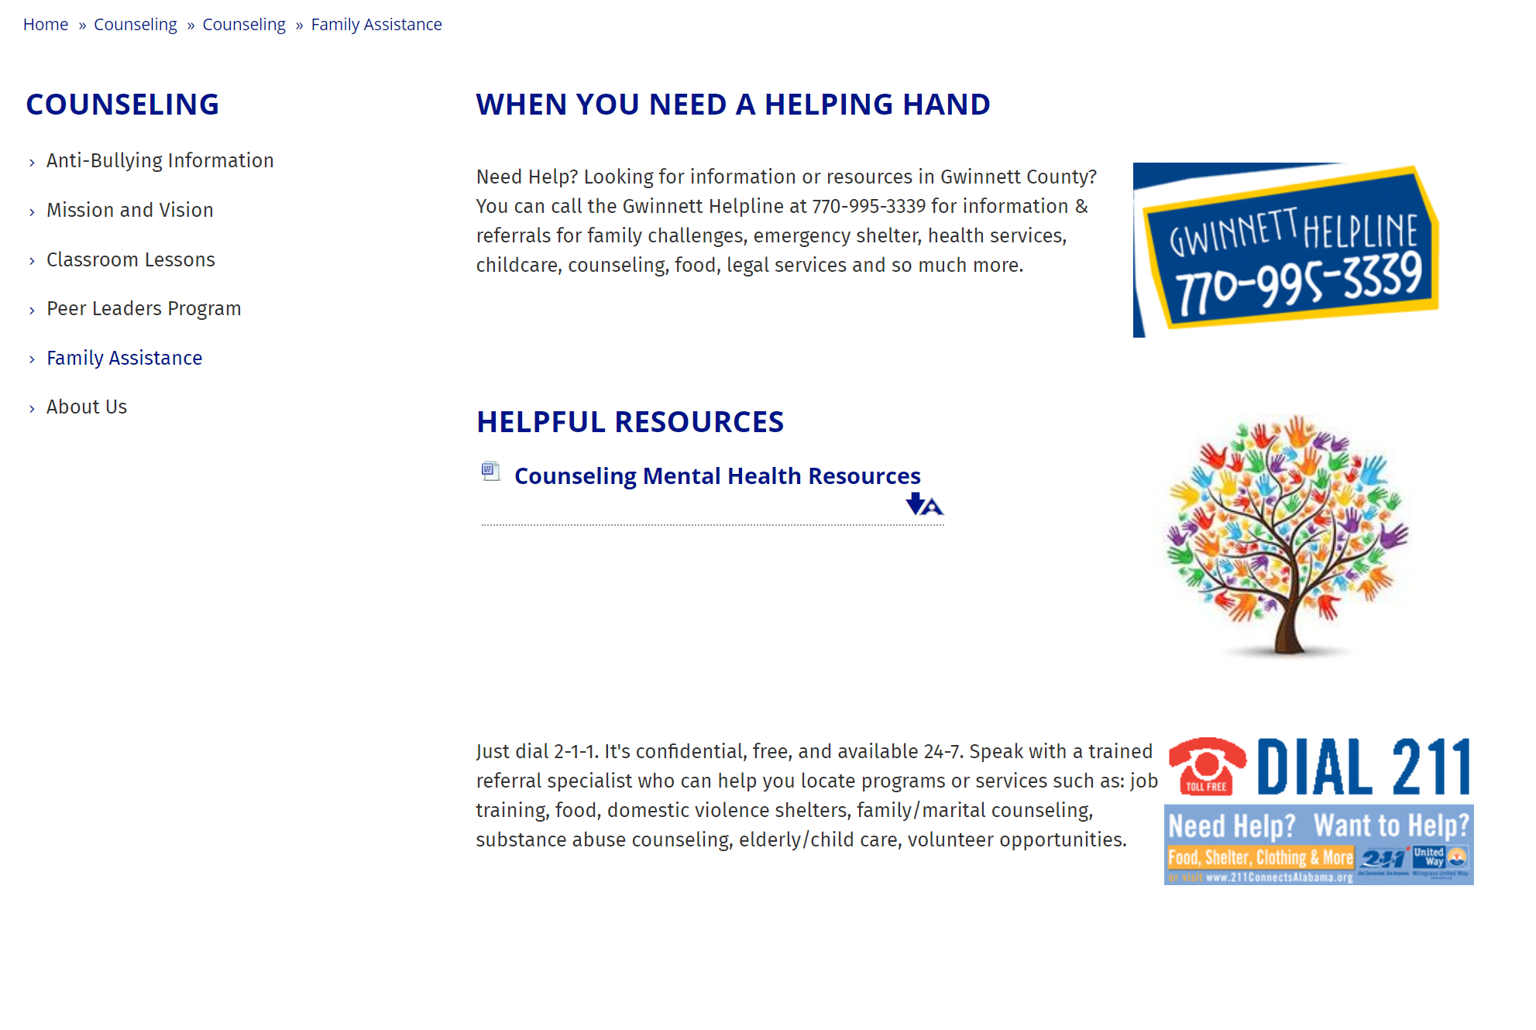
Search Example #1
Search Results
Searched for Family Assistance
All 19 results stayed within subsite and 12 were family assistance.
Search results state Family Assistance Embed Code or Family Assistance Content - app names.
What drives the description noted in the result?

Slide 6
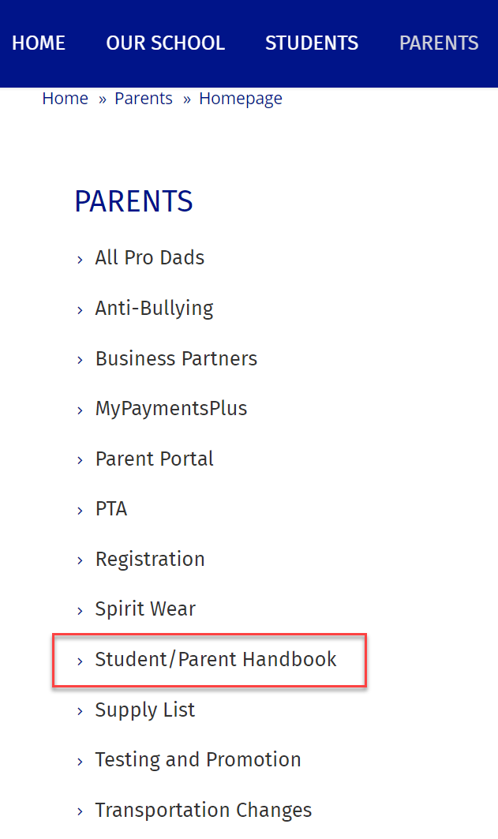
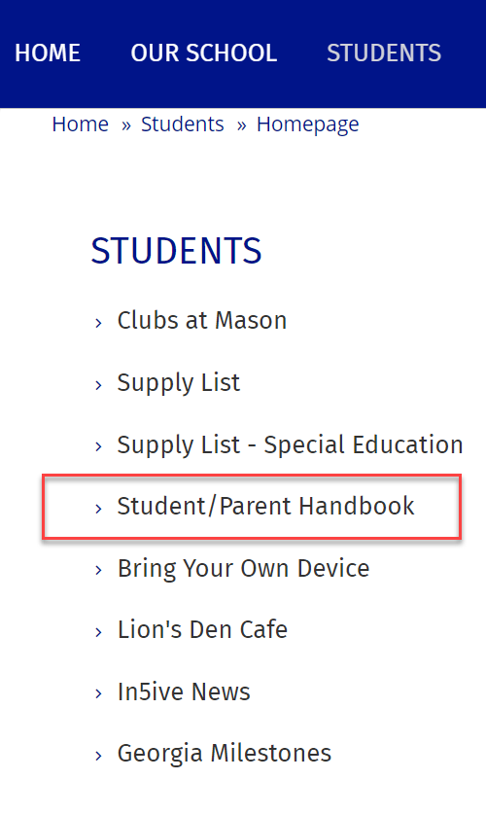
Search Example #2
Searched for Student/Parent Handbook – no results.
Note: This section is (redirect) linked to a district page (non- Bb site).
Should the search results return the section, which is specifically named, with the link to the outside site?

Slide 7
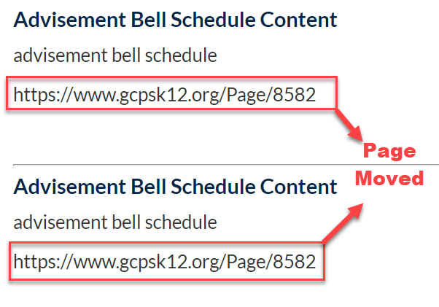
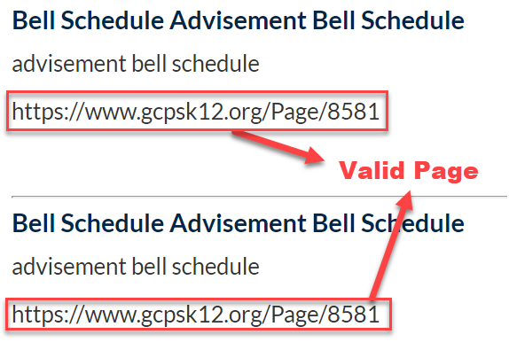
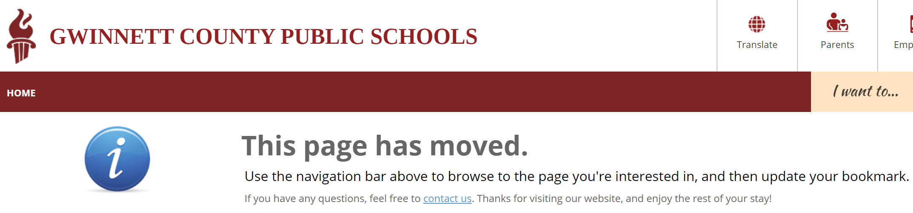
Search Example #3
Searched for Bell Schedule.
Results revealed two pages that are valid and two pages that have been deleted.
Why would the search results reveal pages that are in the recycle bin?

Slide 8
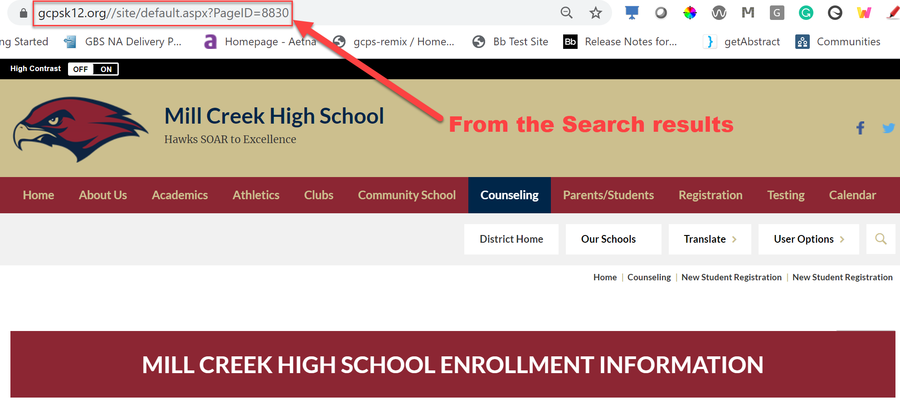
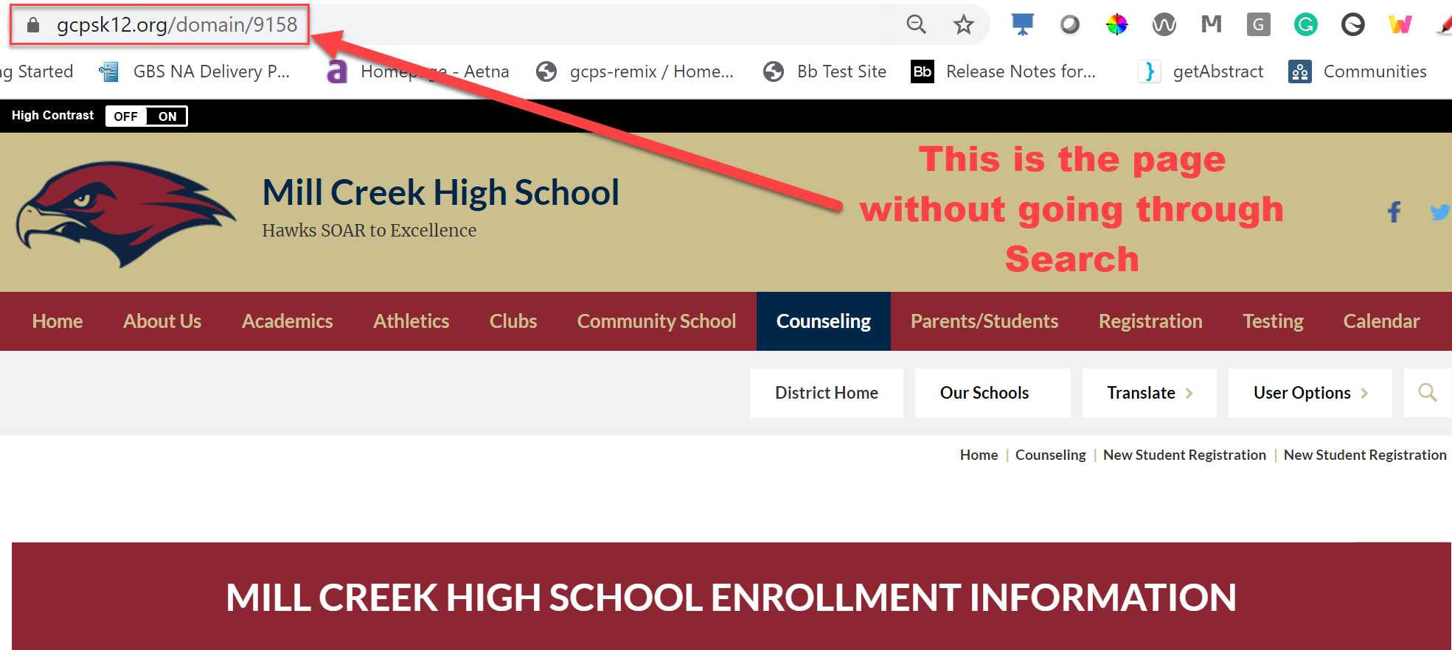
Search Example #4
Searched for Registration.
Page ID 8830 revealed in search results but the correct page ID is 9158 not in search results.
Any reason why the search would not reveal the correct page? Both links are correct.
https://www.gcpsk12.org//site/default.aspx?PageID=8830
https://www.gcpsk12.org/domain/9158

Slide 9

Roadmap Discussion
Microsoft Outlook Calendar integration plans

Slide 10
Issues Update
Issue | Status
HTML Heading Structure does not start at the right level – Onscreen Alert
Document Viewer load errors

Slide 11
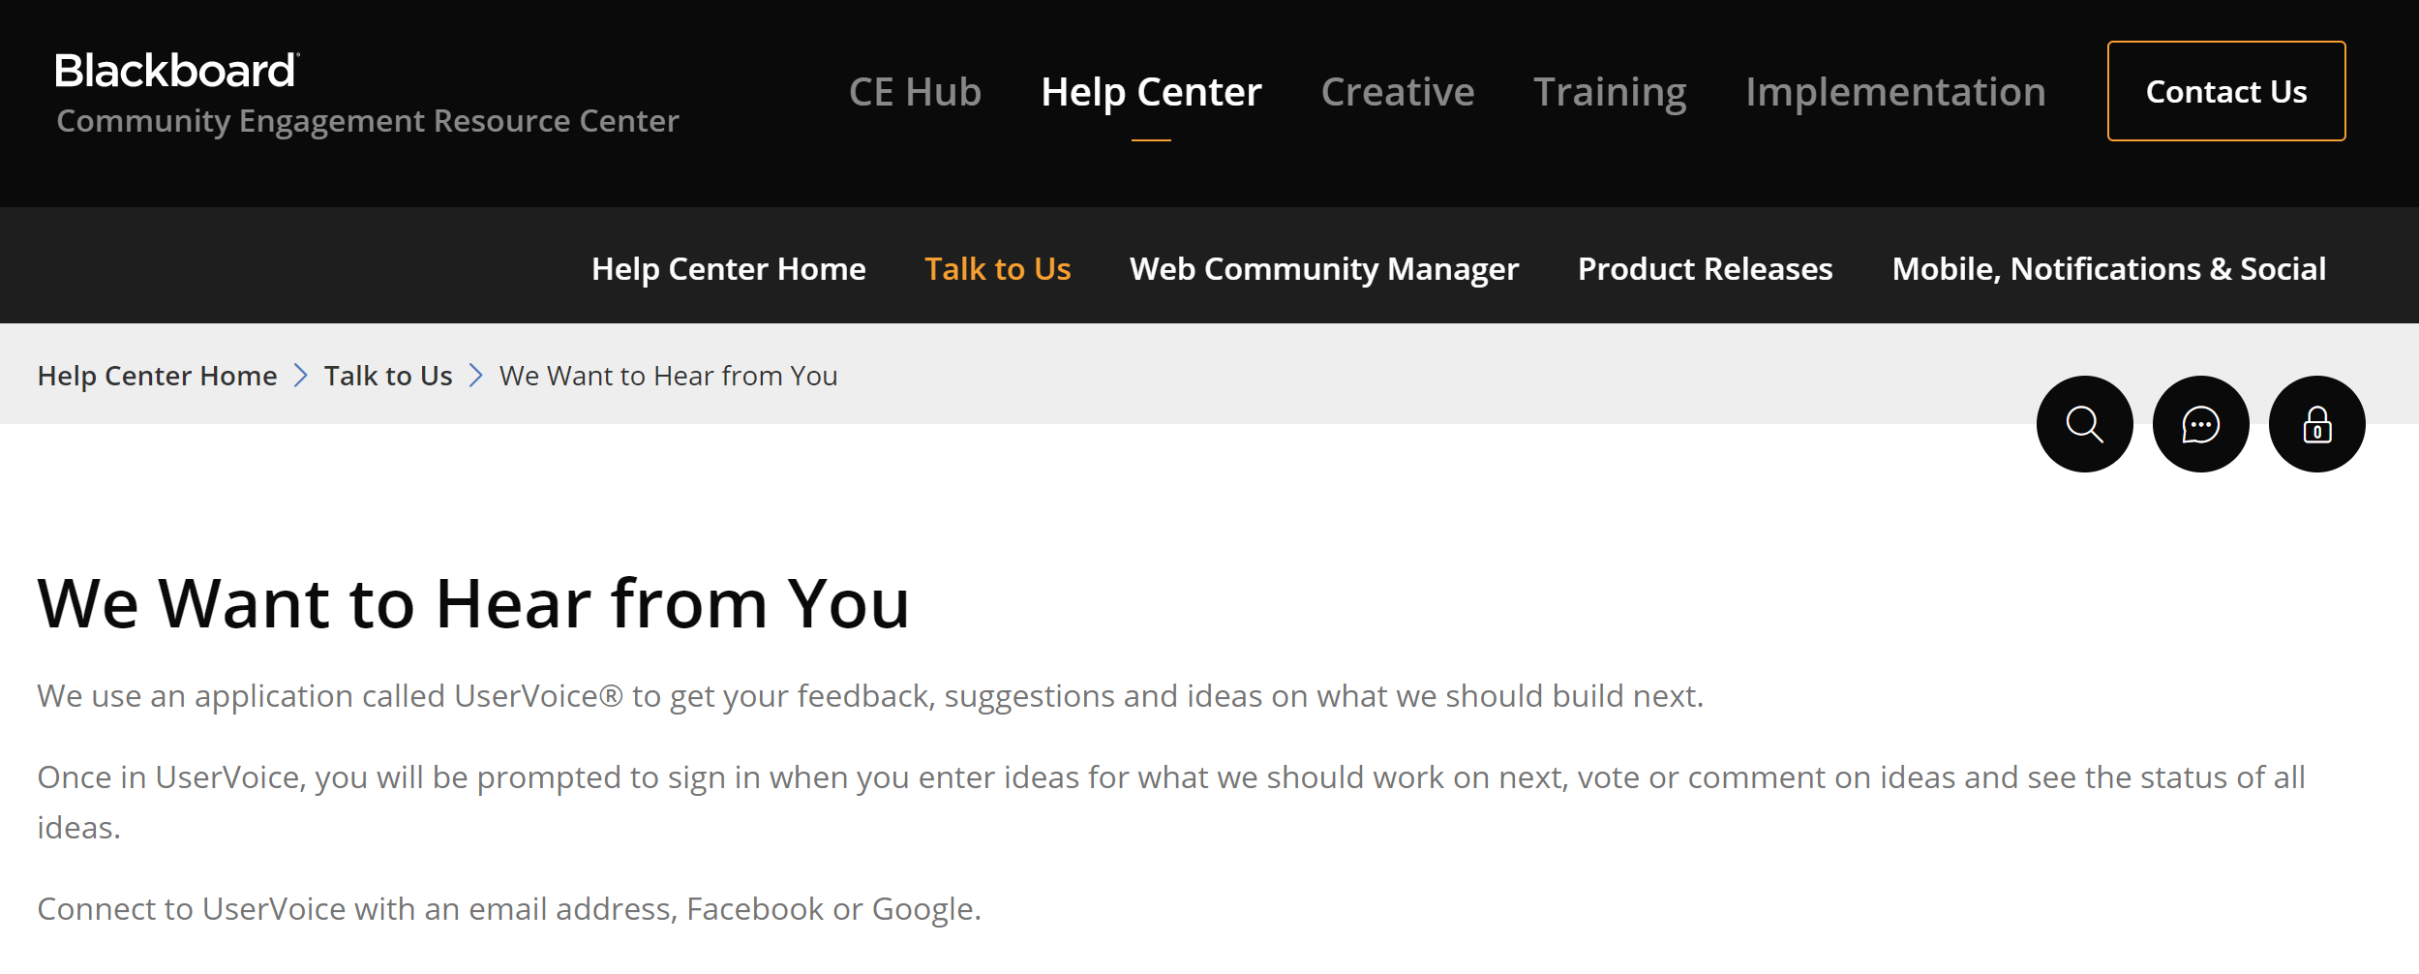
Enhancement Requests
WCM and Ally ideas
How does the process work?

